Slide 1
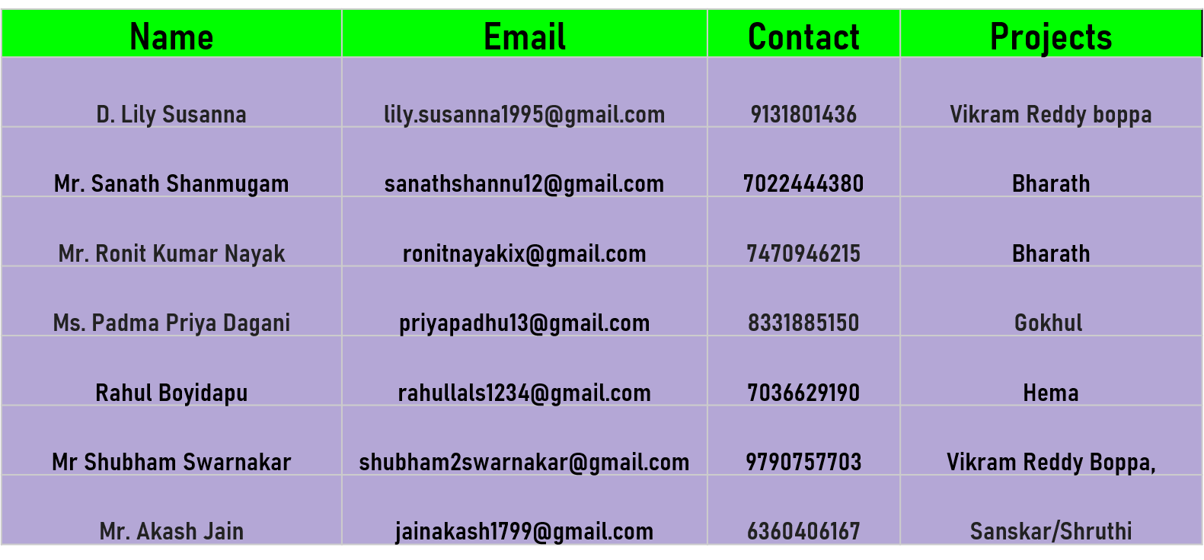
HOTEL REVIEW PREDICTION
P-170
Group-1
Mentor-
Project Coordinator- Mr. Himavanth Ila
24/11/2022

Slide 2
Business Problem:
Objective:
To find out what are the major attributes or features that the travelers look for in a hotel
With this manager can understand which elements of their hotel influence more informing a positive review or improves hotel brand image.

Slide 3
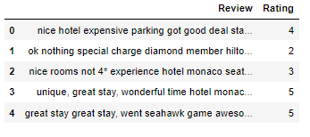
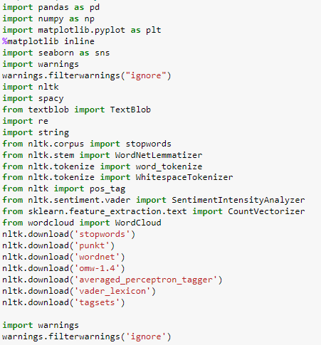
HOTEL REVIEW CLASSIFICATION
IMPORT LIBRARIES:
IMPORT DATASET:
Here, Rating is our target or say ‘Y’ column.
Now, since we already have target we need to convert text data in review column to numerical data/ features or say ‘X’ with the help of steps such as vectorisation. But before that we need to do data preprocessing to clean the data with the help of removing stop words, stemming/Lemmatization.

Slide 4
Dependent and independent variables
Feature(Independent variable)
Target (Dependent variable)
Review | Rating
nice hotel expensive parking got good deal sta... | 4
ok nothing special charge diamond member hilto... | 2
nice rooms not 4* experience hotel monaco seat... | 3
unique, great stay, wonderful time hotel monac... | 5
great stay great stay, went seahawk game aweso... | 5

Slide 5
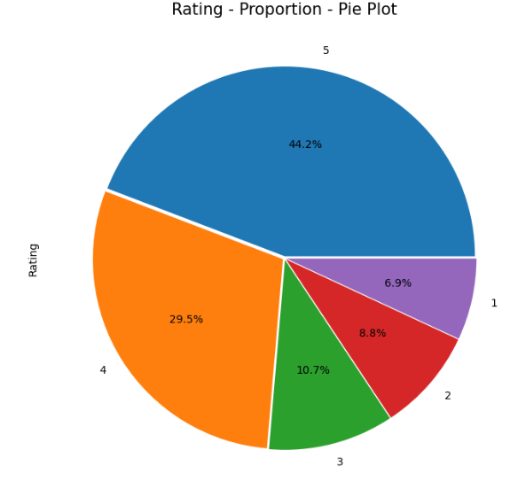
Observations from Data:
df.shape -- (20491, 2)
Minimum Rating = 1
Maximum Rating = 5
On average, user gives Rating 4
Review -- object
Rating -- int64
df.dtypes --
From Pie Plot, we can observe that
44.2 % of the people have given Rating 5
29.5% of the people have given Rating 4
Only 6.9 % of the people have given Rating 1
This shows that Ratings are not in same proportion

Slide 6
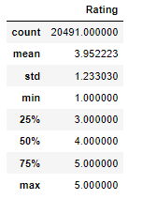
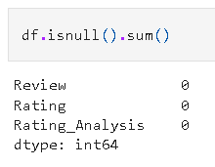
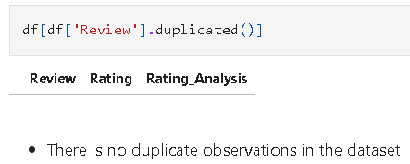
Observations from Data:
Rating | Supporting Review Quantity
5 | 9054
4 | 6039
3 | 2184
2 | 1793
1 | 1421
There is no null or missing entries in both the columns Review and Rating
There is no duplicated observation in the dataset as well

Slide 7
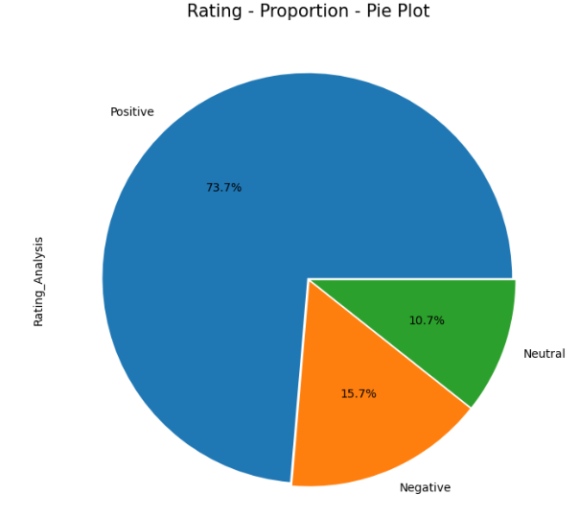
We are re-arranging the rating into 3 classes for the ease of sentiment classification.
RATING
1
2
3
4
5
SENTIMENT
NEGATIVE
NEUTRAL
POSITIVE
Computing
Rating 1 & 2 as Negative
Rating 3 as Neutral and
Rating 4 & 5 as Positive
Positive = 15093
Neutral = 2184
Negative = 3214

Slide 8
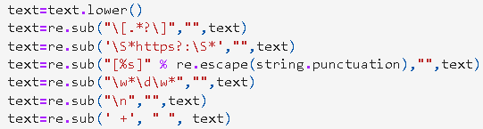
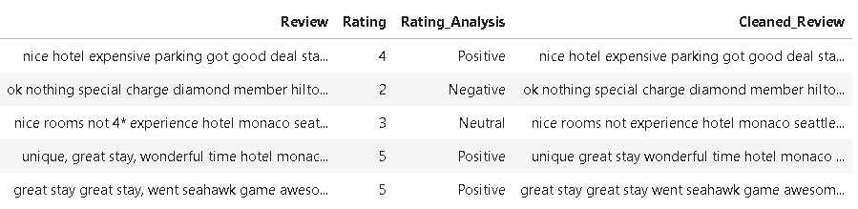
Exploratory Data Analysis (EDA)
Data Preprocessing:
Removing punctuations
Removing Stop words
Lower casing
Tokenization
Lemmatization/Stemming

Slide 9

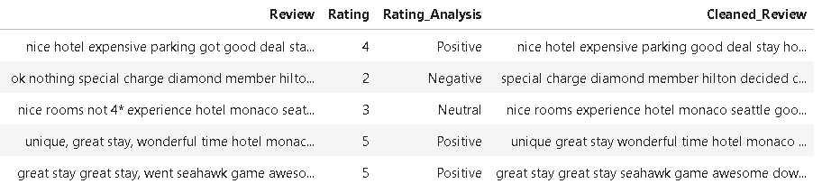

Slide 10
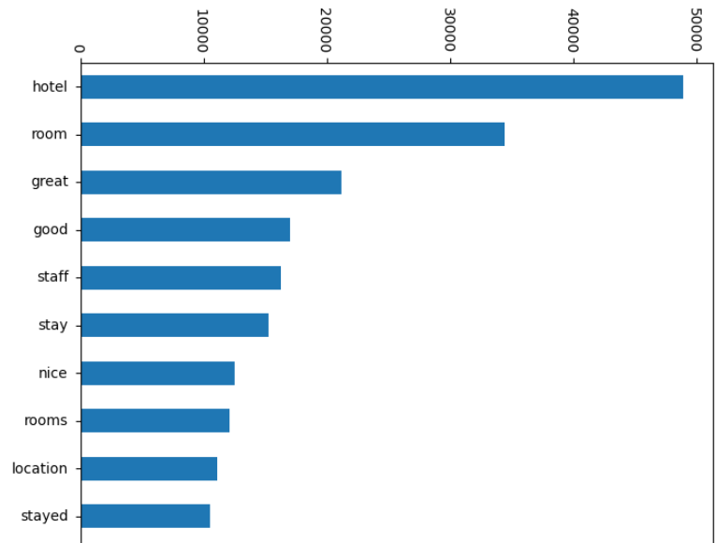
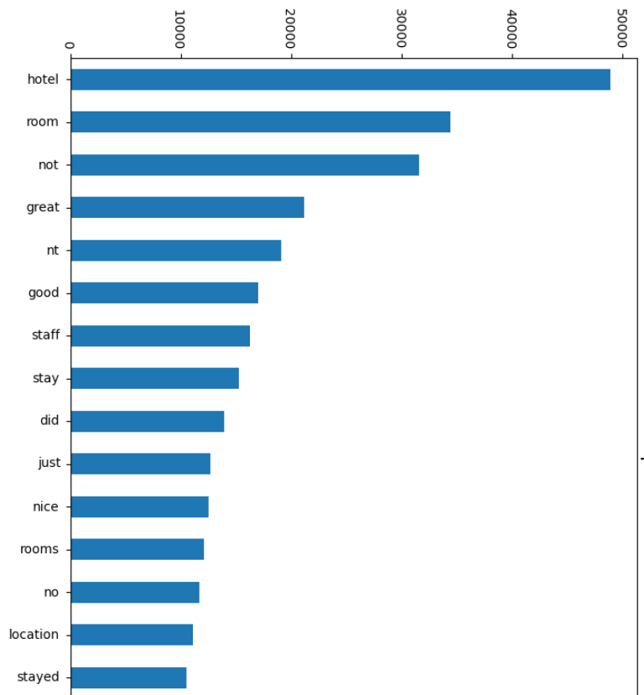
Most Frequent Words before removing stop words
Most Frequent Words after removing stop words

Slide 11
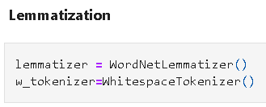
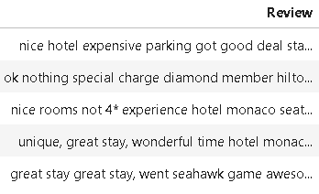
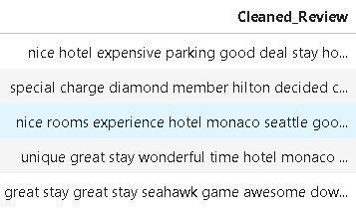
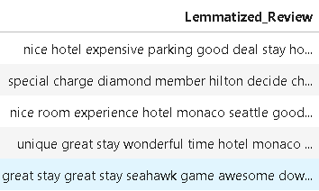

Slide 12
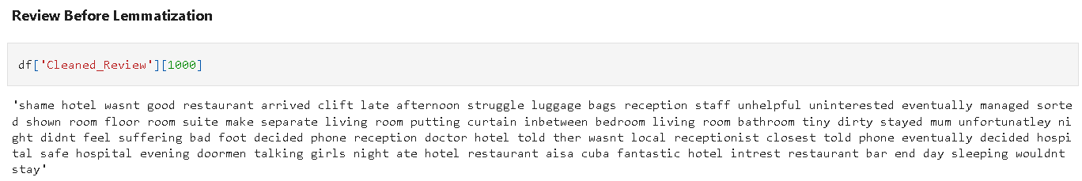
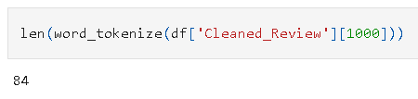
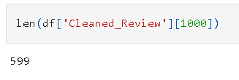

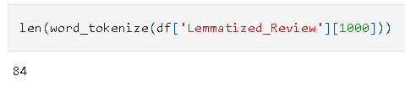

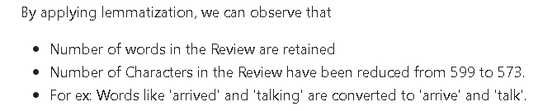

Slide 13
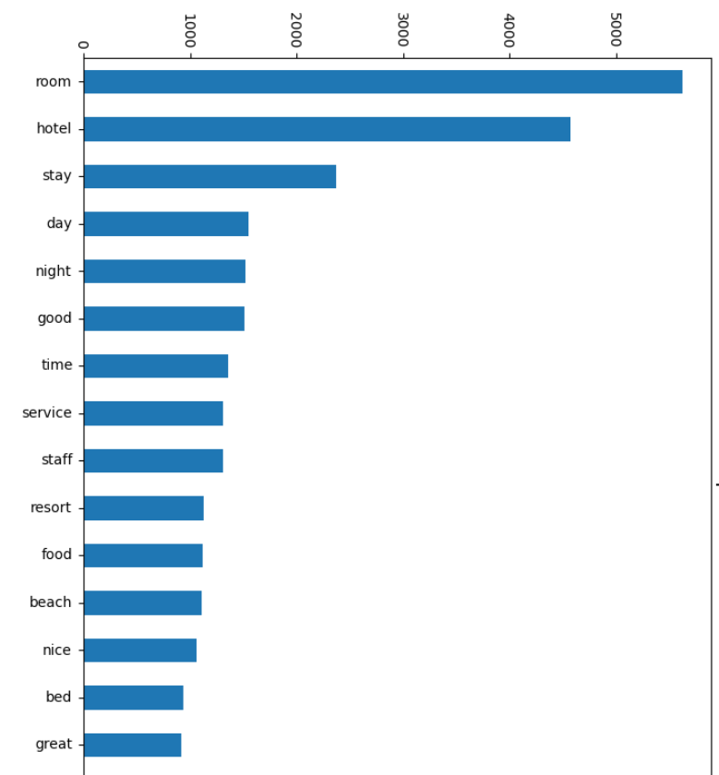
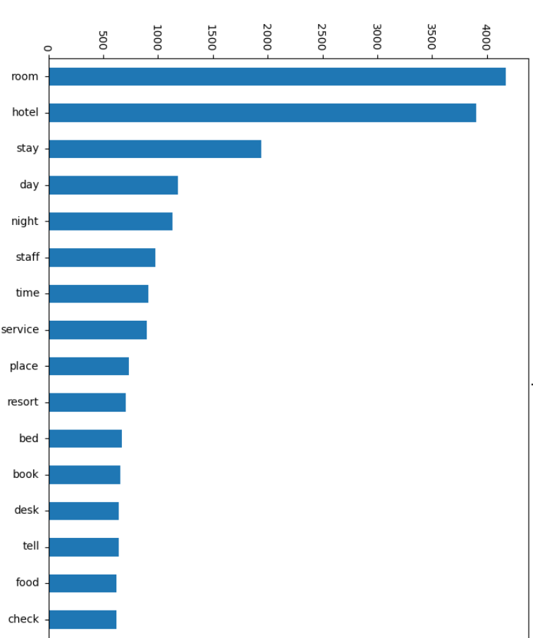

Slide 14
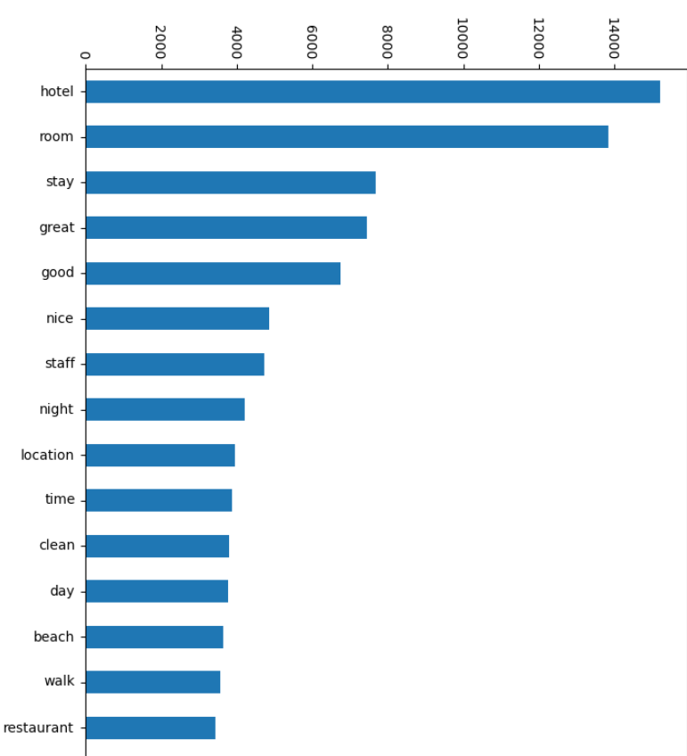
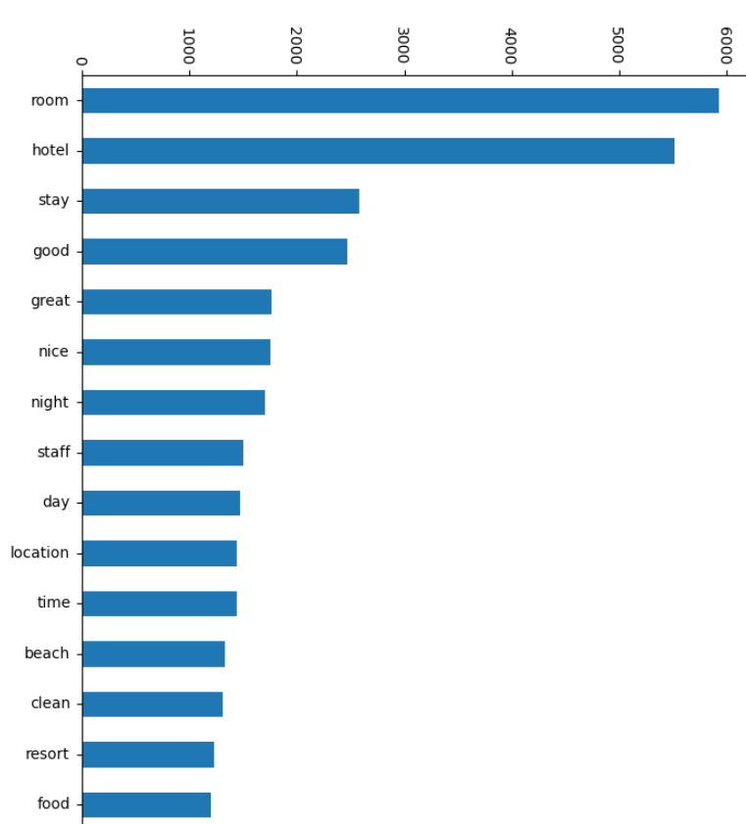

Slide 15
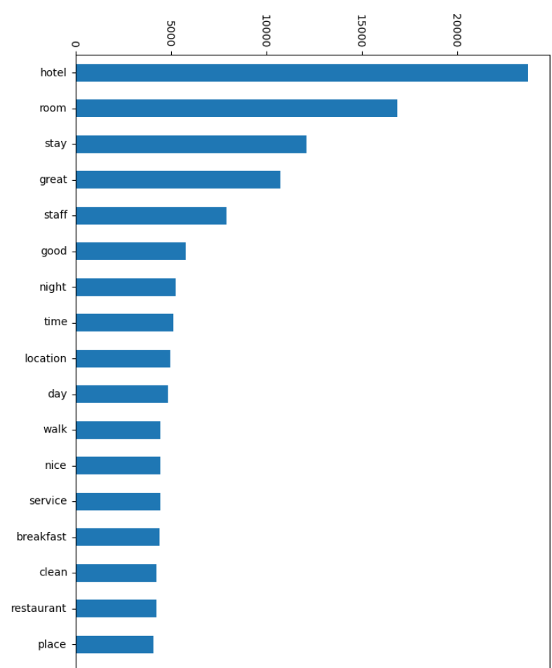

Slide 16

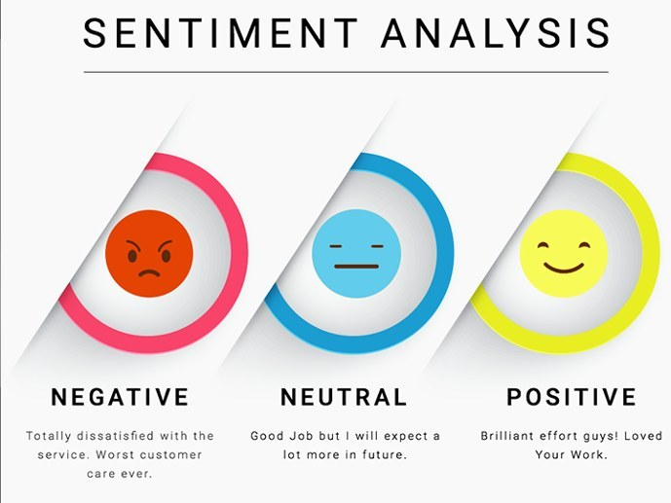
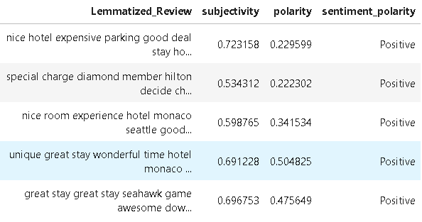
Polarity is float which lies in the range of [-1,1] where 1 means positive statement and -1 means a negative statement.
Subjective sentences generally refer to personal opinion, emotion or judgment whereas objective refers to factual information. Subjectivity is also a float which lies in the range of [0,1].

Slide 17
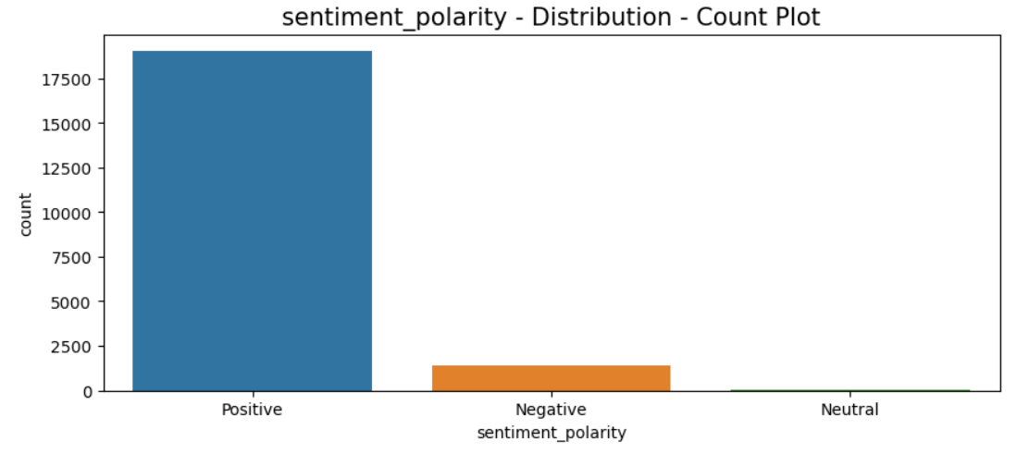

Slide 18
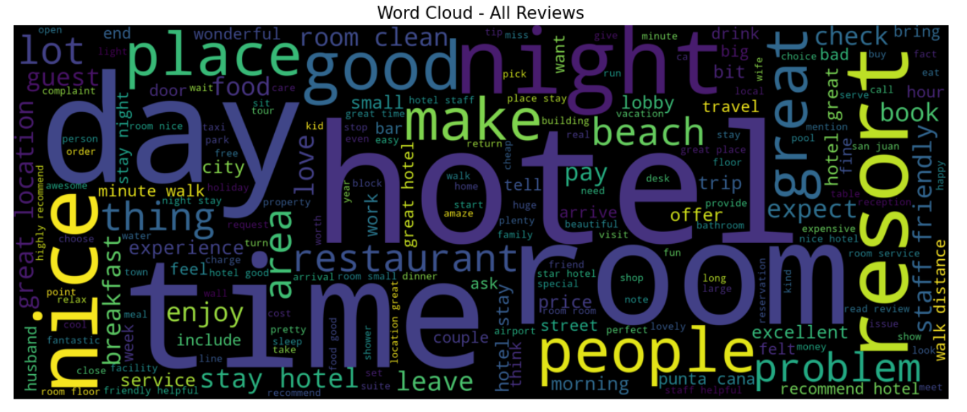

Slide 19
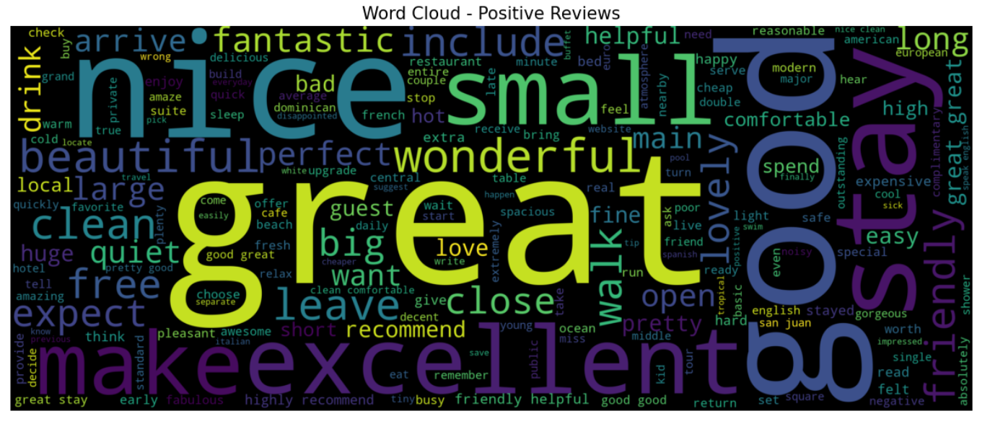

Slide 20
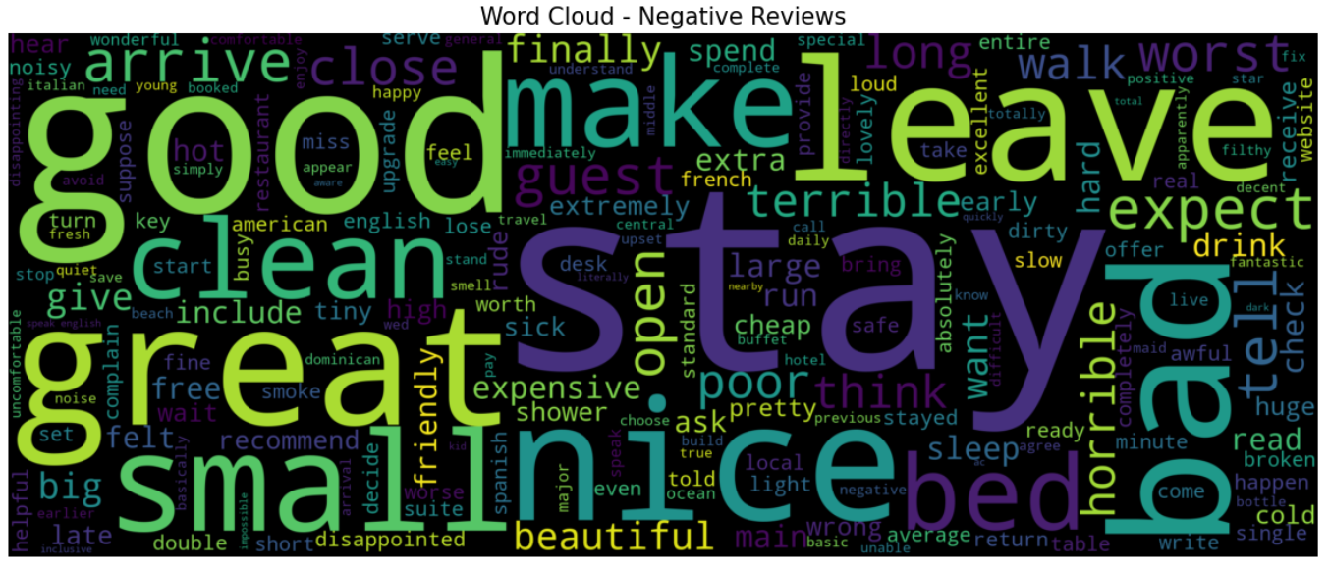

Slide 21
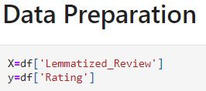

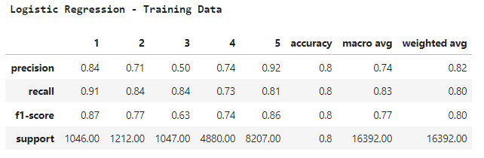
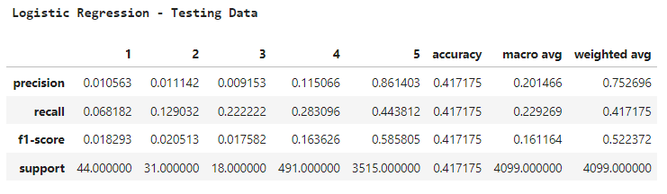
Model Building
TF - IDF Vectorization
This is very common algorithm to transform text into a meaningful representation of numbers which is used to fit machine algorithm for prediction. Count Vectorizer give number of frequency with respect to index of vocabulary where as tf-idf consider overall documents of weight of words.
Model Evaluation / Model Testing

Slide 22
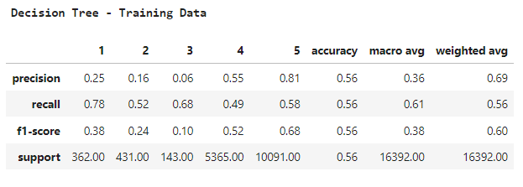
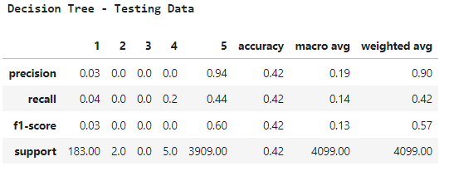
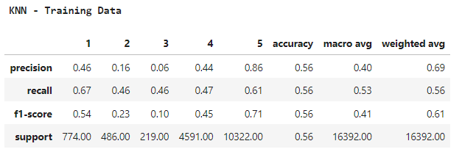
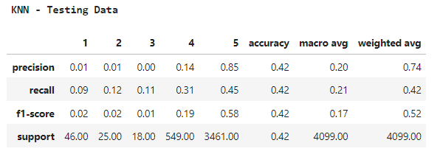
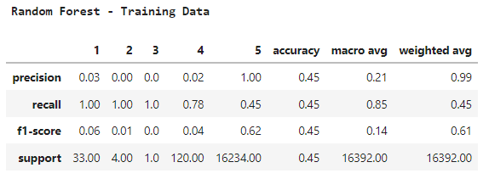
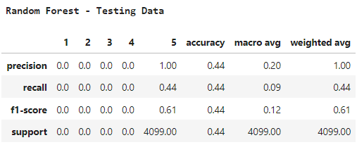

Slide 23
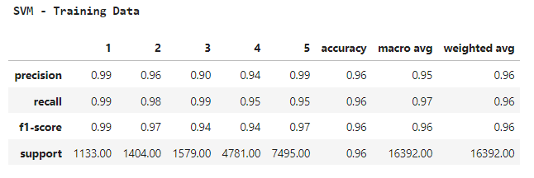
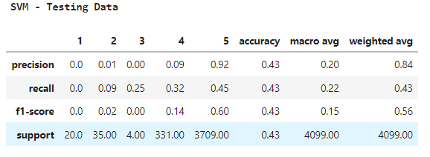
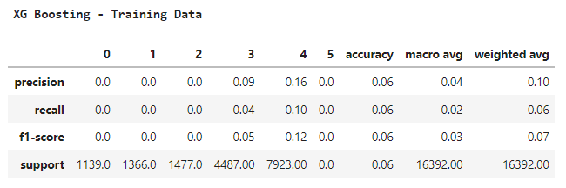
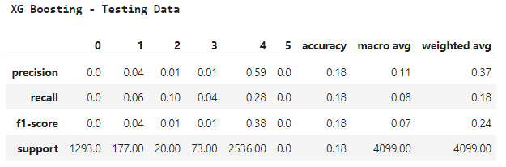
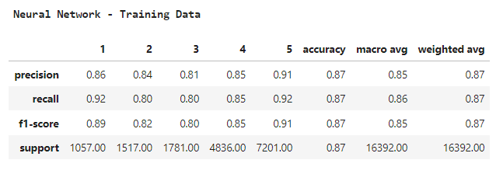
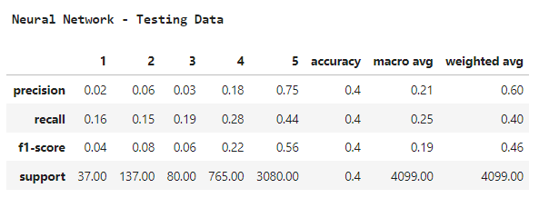

Slide 24
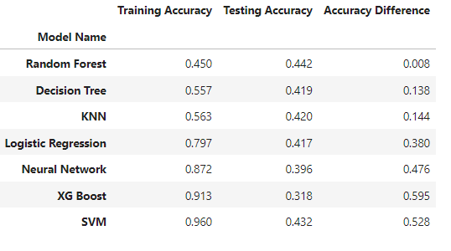
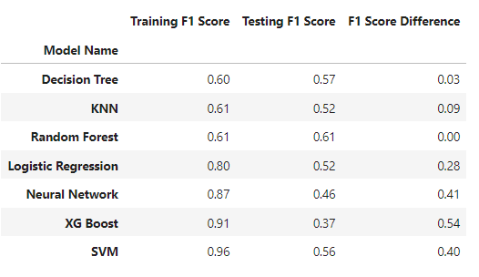
Model Evaluation

Slide 25

Final Model: SVM
The final model selected out of
SVM model was yielding higher accuracy and hence was chosen to train the model with SVM.
The final model has been deployed using streamlit.

Slide 26


Streamlit code to import all the required libraries and aslo showing part code.

Slide 27

Streamlit code showing the deployment of the model and a snippet of text pre-processing and lemmatization

Slide 28

Streamlit code to get all the keywords from the user’s review and also to obtain the important parameters

Slide 29

The deployed model showing the prediction for a review to be negative along with the words that were responsible for this prediction

Slide 30

The deployed model showing the prediction for a review to be positive along with the words that were responsible for this prediction

Slide 31
THANK YOU !!!

